Slide 1
Process Scheduling Module 4
Operating Systems

Slide 2
Chapter Outline
Scheduler
Scheduling algorithm
Objectives of Scheduling
Criteria for scheduling
CPU-bound vs I/O-bound processes
Types of Scheduling
Process scheduling queues
FCFS
SJF
Priority
Round Robin
Multilevel feedback queues scheduling
BSD Unix scheduling
Multiple processor scheduling

Slide 3
Scheduling
Scheduler
The scheduler is part of the operating system, concerned with which process to run next if multiple run-able processes are in ready queue
Scheduler is concerned with deciding on policy, not providing a mechanism
It is important because it can have a big effect on resource utilization and overall performance of the system
Scheduling Algorithm
In a multiprogramming computer several processes will compete for use of the processor
At any time only one process will be running while other will wait for process to be free
Scheduling algorithm is logic that determines the order in which processes should run when multiple processes are there
The aim of process scheduling is to achieve objectives such as maximum CPU utilization and to improve its performance

Slide 4
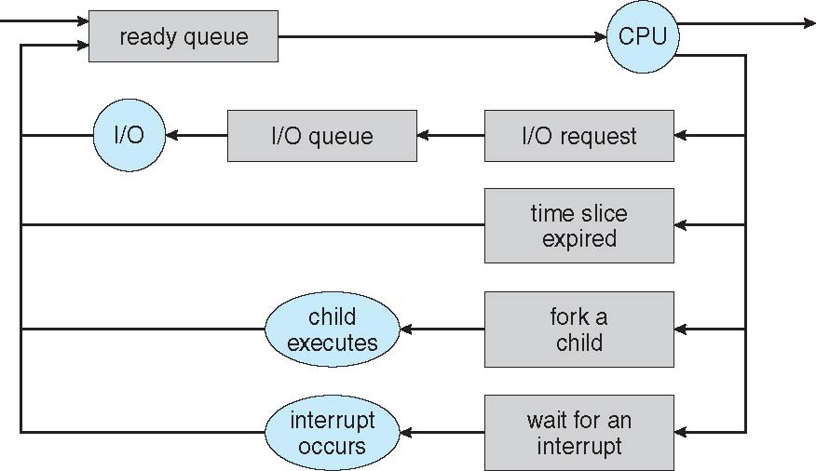
Process Scheduling

Slide 5
Process Scheduling
Maximum CPU utilization obtained with multiprogramming
CPU–I/O Burst Cycle – Process execution consists of a cycle of CPU execution and I/O wait
CPU burst followed by I/O burst
CPU burst distribution is of main concern

Slide 6
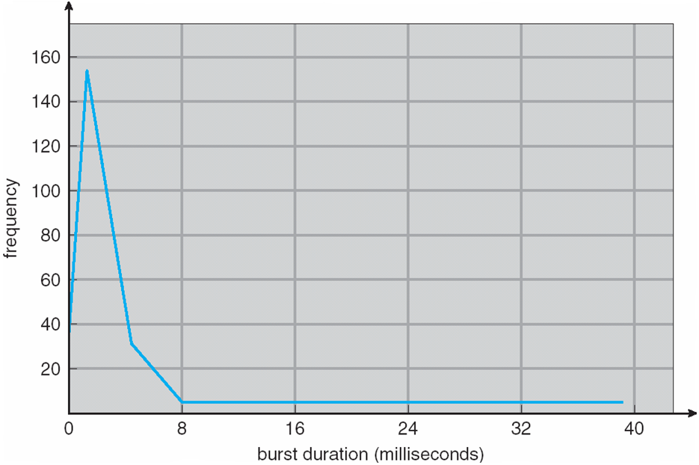
Histogram of CPU-burst Times

Slide 7
CPU Scheduler
Short-term scheduler selects from among the processes in ready queue, and allocates the CPU to one of them
Queue may be ordered in various ways
CPU scheduling decisions may take place when a process:
Switches from running to waiting state
Switches from running to ready state
Switches from waiting to ready
Terminates
Scheduling under 1 and 4 is non-preemptive
All other scheduling is preemptive
Consider access to shared data
Consider preemption while in kernel mode
Consider interrupts occurring during crucial OS activities

Slide 8
Dispatcher
Dispatcher module gives control of the CPU to the process selected by the short-term scheduler; this involves:
switching context
switching to user mode
jumping to the proper location in the user program to restart that program
Dispatch latency
time it takes for the dispatcher to stop one process and start another running

Slide 9
Scheduling Performance
CPU utilization
keep the CPU as busy as possible
Throughput
# of processes that complete their execution per time unit
Turnaround time
amount of time to execute a particular process
Waiting time
amount of time a process has been waiting in the ready queue
Response time
amount of time it takes from when a request was submitted until the first response is produced, not output (for time-sharing environment)

Slide 10
Scheduling Algorithm Objectives
Max CPU utilization
Max throughput
Min turnaround time
Min waiting time
Min response time

Slide 11
Criteria for Scheduling
Priority
Priority assigned to that process or job
Class
Class of job, i.e. batch or on-line or real-time
Resource requirements
E.g. expected run time, memory required, etc
I/O or CPU bound
i.e. whether job is I/O bound or CPU bound
Resources used to date
i.e. the amount of processor time already consumed
Waiting time to date
i.e. the amount of time spent waiting for service so far

Slide 12
Scheduling Philosophies
Preemptive
The system may preempt the CPU from a process at any time;
Prevents any one process from using the CPU for too long
Can lead to race condition (require synchronization techniques)
Non-preemptive
Each process voluntarily gives up the CPU
It is;
Simple
Easy to implement
Not suitable for multi-user systems
If the running process become blocked next process can be scheduled

Slide 13
Process Scheduling Queues
Job queue
Set of all the processes in the system
It also includes the processes from the queues given below
Ready queue
Set of all the processes residing in main memory (ready or waiting)
Device queue
Set of processes waiting for an I/O devices

Slide 14
Levels of Scheduling
Scheduling can be exercised at three levels
High-level scheduling (Long-term scheduler)
Allow limited number of processes in the ready queue to compete
It disallows processes beyond a certain limit for batch processes first and in the end also the interactive processes
Invoke less frequently
May be slow
Medium-level scheduling (Medium-term scheduler)
It is concerned with decision to temporarily remove a process from the system (to reduce system load)
To reintroduce a process or swapping in
What if there is room in memory and both a new process as well as swapped out process want to be loaded
In this case, medium level scheduler has to work in close conjunction with high level scheduler

Slide 15
Levels of Scheduling
Low level-scheduling (Short-term scheduler)
Handles the decisions of which process is to be assigned to the processor (dispatcher)
Invoke very frequently
Must execute fast
Its scheduling could be preemptive or non-preemptive
Dispatch latency should be minimum
Dispatch latency is the time it takes for the dispatcher to stop one process and start another running
Example:
Assume a process runs for 90ms and scheduler run for 10ms
Overheads = 10/(90+10) = 10%
Any OS may use one or all of these levels, depending upon the desired
These levels have to interact amongst themselves quite closely to ensure that the computing resources are managed optimally
The exact algorithms for these and interaction between them are quite complex

Slide 16
Schedulers in Operating System
Scheduler | Key Decision | Runs On | Frequency
Long-Term | Which jobs to admit | Disk → Main Memory | Low
Medium-Term | Which jobs to suspend/resume | Main Memory ↔ Disk | Medium
Short-Term | Which process gets CPU | Ready Queue → CPU | High

Slide 17
Scheduling Algorithms

Slide 18
First Come First Serve Scheduling
The FCFS simply assign the processor to the process which is first in ready queue
When the processor is free, the next process at the head of the ready queue will be selected
Consider the following set of three processes that arrive at time ‘0’
Process ID Priority Burst Time
P1 2 30 ms
P2 3 6 ms
P3 1 4 ms
The waiting time for each process is P1=0, P2=30, P3=36
The average waiting time is (0+30+36)/3 = 22ms
The average waiting time of FCFS may vary substantially if the process’s CPU burst time vary greatly
P₁
P₂
P₃
0
30
36
40

Slide 19
First Come First Serve Scheduling
Salient points of FCFS
It is the simplest scheduling algorithm
Also know as the first in first out (FIFO)
FCFS is non-preemptive
It performs much better for long processes than short processes
It tend to favor CPU-bond processes over I/O bound
It is not suitable for time sharing system
FCFS is rarely used on its own but is effective if combined with other scheme

Slide 20
Practice Example (FCFS)
Process | Arrival Time (ms) | Burst Time (ms)
P1 | 0 | 5
P2 | 2 | 3
P3 | 4 | 8
1. Sort Processes by Arrival Time
2. Design Gantt Chart
3. Calculate Waiting Time & Turnaround Time
4. Calculate Averages (Average waiting & Turnaround Time)

Slide 21
Solution
Step 1: Sort Processes by Arrival Time
Since FCFS executes the process that arrives first, we arrange them by arrival order:
P1 → P2 → P3
Step 2: Gantt Chart
Let’s schedule them in order:
| P1 | P2 | P3 |
0 5 8 16
Step 3: Calculate Waiting Time & Turnaround Time
Process | Arrival Time | Burst Time | Start Time | Finish Time | Waiting Time | Turnaround Time
P1 | 0 | 5 | 0 | 5 | 0 | 5
P2 | 2 | 3 | 5 | 8 | 5 − 2 = 3 | 8 − 2 = 6
P3 | 4 | 8 | 8 | 16 | 8 − 4 = 4 | 16 − 4 = 12
Step 4: Calculate Averages
Average Waiting Time = (0 + 3 + 4) / 3 = 2.33 ms
Average Turnaround Time = (5 + 6 + 12) / 3 = 7.67 ms

Slide 22
Shortest Job First Scheduling
This algorithm associates with shortest job first
When the CPU is available, it is assigned to the process that has smallest CPU burst time
If two processes have same CPU-burst then FCFS scheduling is used along with this to break the tie
Moving a short process before a long one
Decrease the waiting time of short process
Increase the waiting time of long process
Consequently, the average time decreases
This will result in a smaller number of PCB’s in the ready or blocked queues
The search time will be smaller, thus improving the response time
The number of satisfied user will increase
A long job in the queue may delayed indefinitely by a succession of smaller jobs arriving in ready queue
This can be avoided by setting higher external priority to those important jobs
The OS at any time can calculates a resultant priority based on both
Also known as shortest job next

Slide 23
Shortest Job First Scheduling
Salient Points of SJF
SJF may be preemptive or non-preemptive
It will preempt the currently executing process if its remaining time is greater than that of a newly arrived process
This scheme is known as shortest remaining time first
SJF is optimal in sense that it yields the smallest average waiting time
In general, it is difficult to predict the CPU time requirement for a process
SJF is optimal for batch jobs for which the run times are known in advance
SJF reduces average waiting time over FCFS

Slide 24
Shortest Job First Scheduling Non-Preemptive SJF Scheduling
Process Arrival Time Burst Time
P₁ 0.0 7
P₂ 2.0 4
P₃ 4.0 1
P₄ 5.0 4
SJF (non-preemptive)
Average waiting time = (0 + 6 + 3 + 7)/4 = 4
P₁
P₃
P₂
P₄
0
3
7
8
12
16

Slide 25
Completion, Turnaround and Waiting times
Turnaround = Completion − Arrival Waiting = Turnaround − Burst
Process | Arrival | Burst | Completion C | Turnaround (C−A) | Waiting (TAT − Burst)
P₁ | 0 | 7 | 7 | 7 − 0 = 7 | 7 − 7 = 0
P₂ | 2 | 4 | 12 | 12 − 2 = 10 | 10 − 4 = 6
P₃ | 4 | 1 | 8 | 8 − 4 = 4 | 4 − 1 = 3
P₄ | 5 | 4 | 16 | 16 − 5 = 11 | 11 − 4 = 7
Totals / averages:
Average turnaround time = (7 + 10 + 4 + 11) / 4 = 8 units
Average waiting time = (0 + 6 + 3 + 7) / 4 = 4 units
Final answer
Average waiting time = 4 units
Average turnaround time = 8 units

Slide 26
Shortest Job First Scheduling Preemptive SJF Scheduling
Process Arrival Time Burst Time
P₁ 0.0 7
P₂ 2.0 4
P₃ 4.0 1
P₄ 5.0 4
SJF (preemptive)
P₁
P₂
P₃
P₂
P₄
P₁
0
2
4
5
7
11
16

Slide 27
Completion, Turnaround and Waiting times
Compute completion time (C), turnaround = C − arrival, waiting = turnaround − burst.
Process | Arrival | Burst | Completion C | Turnaround (C−A) | Waiting (TAT−Burst)
P₁ | 0 | 7 | 16 | 16 | 16 − 7 = 9
P₂ | 2 | 4 | 7 | 7 − 2 = 5 | 5 − 4 = 1
P₃ | 4 | 1 | 5 | 5 − 4 = 1 | 1 − 1 = 0
P₄ | 5 | 4 | 11 | 11 − 5 = 6 | 6 − 4 = 2
Totals / averages:
Average turnaround time = (16 + 5 + 1 + 6) / 4 = 28 / 4 = 7
Average waiting time = (9 + 1 + 0 + 2) / 4 = 12 / 4 = 3
Average waiting time = 3 units. Average turnaround time = 7 units.

Slide 28
Round Robin Scheduling
The Round-Robin (RR) scheduling is designed especially for time sharing systems
In this algorithm there is small unit of time known as time quantum
A time quantum is generally up to 10-100ms
CPU scheduler goes around the ready queue, allocating the CPU to each process for a time interval of up to 1 quantum

Slide 29
Round Robin Scheduling
For RR scheduling we keep the ready queue as a FIFO queue of processes
The CPU picks up the first process from the ready queue, set a timer to interrupt after 1 quantum
If the process burst time is less than 1 quantum
then the process itself release the CPU voluntarily & proceed to next process
If the process burst time is greater then 1 quantum
then that process is sent back to the ready queue and CPU scheduler selects the next process in the ready queue for scheduling

Slide 30
Round Robin Scheduling
Process Burst Time
P₁ 53
P₂ 17
P₃ 68
P₄ 24
Time quantum = 20 ms
The Gantt chart is:
Typically, higher average turnaround than SJF, but better response
P₁
P₂
P₃
P₄
P₁
P₃
P₄
P₁
P₃
P₃
0
20
37
57
77
97
117
121
134
154
162

Slide 31
Priority Scheduling
In priority scheduling a priority is associated with each process and the CPU is allocated to the process with the highest priority
Equal priority processes are scheduled in FCFS order
Priorities are generally some fixed range of numbers, such as 0, 1, 5, 10
There is no general agreement on whether ‘0’ is highest or lower priority
Priority can be defined on the bases of following
Process time limit
Memory requirements
Number of open files
Ratio of average I/O burst to CPU burst

Slide 32
Priority Scheduling - Salient points
Priority mechanism can be static or dynamic
Static priority mechanism is easy to implement and have relatively low overheads
Dynamic priority mechanism is more complex to implement and have greater overheads
The priority scheduling may be preemptive or non-preemptive
The choice arise when a high priority process comes in the queue while a low priority process is executing
A process that is ready to run but lacking the CPU can be considered blocked
Solution to indefinite blocking is aging
Aging is a technique of gradually increasing the priority of processes that waits for a long time
OS allows only a limited priority classes
In VAX / VMS priority range is 0 to 31
In Unix priority range is -20 to 20

Slide 33
Multilevel Queue
Ready queue is partitioned into separate queues: foreground (interactive) background (batch)
Each queue has its own scheduling algorithm
foreground – RR
background – FCFS
Scheduling must be done between the queues
Fixed priority scheduling; (i.e., serve all from foreground then from background)
Possibility of starvation
Time slice – each queue gets a certain amount of CPU time which it can schedule amongst its processes; i.e., 80% to foreground in RR
20% to background in FCFS

Slide 34
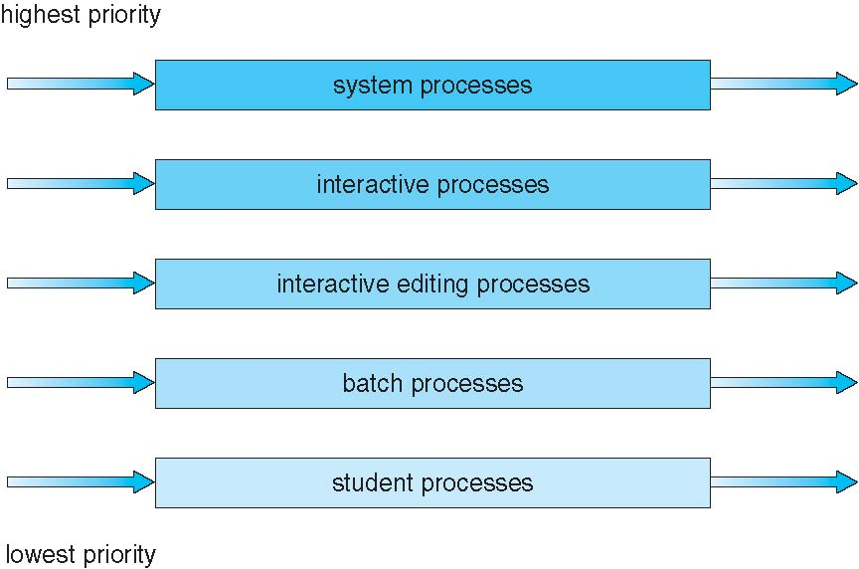
Multilevel Queue Scheduling

Slide 35
Multilevel Feedback Queue
A process can move between the various queues
aging can be implemented this way
Multilevel-feedback-queue scheduler defined by the following parameters:
number of queues
scheduling algorithms for each queue
method used to determine when to upgrade a process
method used to determine when to demote a process
method used to determine which queue a process will enter when that process needs service

Slide 36
Multilevel Feedback Queue
Example
Three queues:
Q₀ – time quantum 8 milliseconds
Q₁ – time quantum 16 milliseconds
Q₂ – FCFS
Scheduling
A new job enters queue Q₀ which is served FCFS
When it gains CPU, job receives 8 milliseconds
If it does not finish in 8 milliseconds, job is moved to queue Q₁
At Q₁ job is again served FCFS and receives 16 additional milliseconds
If it still does not complete, it is preempted and moved to queue Q₂

Slide 37

Multilevel Feedback Queues

Slide 38
Thread Scheduling

Slide 39
Thread Scheduling
Distinction between user-level and kernel-level threads
When threads supported, threads scheduled, not processes
Process-contention scope (PCS)
Thread library schedules user-level threads to run on LW
Scheduling competition is within the process
Typically done via priority set by programmer
Many-to-one and many-to-many models
System-contention scope (SCS)
Kernel thread scheduled onto available CPU
Competition among all threads in system

Slide 40
Pthread Scheduling
API allows specifying either PCS or SCS during thread creation
PTHREAD_SCOPE_PROCESS schedules threads using PCS scheduling
PTHREAD_SCOPE_SYSTEM schedules threads using SCS scheduling
Can be limited by OS
Linux and macOS only allow PTHREAD_SCOPE_SYSTEM

Slide 41
Pthread Scheduling API
#include <pthread.h>
#include <stdio.h>
#define NUM_THREADS 5
int main(int argc, char *argv[]) {
int i, scope; pthread_t tid[NUM THREADS];
pthread_attr_t attr;
/* get the default attributes */
pthread_attr_init(&attr);
/* first inquire on the current scope */ if (pthread_attr_getscope(&attr, &scope) != 0)
fprintf(stderr, "Unable to get scheduling scope\n");
else {
if (scope == PTHREAD_SCOPE_PROCESS)
printf("PTHREAD_SCOPE_PROCESS");
else if (scope == PTHREAD_SCOPE_SYSTEM)
printf("PTHREAD_SCOPE_SYSTEM");
else fprintf(stderr, "Illegal scope value.\n");
}

Slide 42
Pthread Scheduling API
/* set the scheduling algorithm to PCS or SCS */
pthread_attr_setscope(&attr, PTHREAD_SCOPE_SYSTEM);
/* create the threads */ for (i = 0; i < NUM_THREADS; i++)
pthread_create(&tid[i],&attr,runner,NULL);
/* now join on each thread */ for (i = 0; i < NUM_THREADS; i++)
pthread_join(tid[i], NULL);
}
/* Each thread will begin control in this function */
void *runner(void *param) {
/* do some work ... */
pthread_exit(0);
}

Slide 43
Multiple-Processor Scheduling
CPU scheduling more complex when multiple CPUs are available
Multiprocessor may be any one of the following architectures:
Multicore CPUs
Multithreaded cores
NUMA systems
Heterogeneous multiprocessing

Slide 44
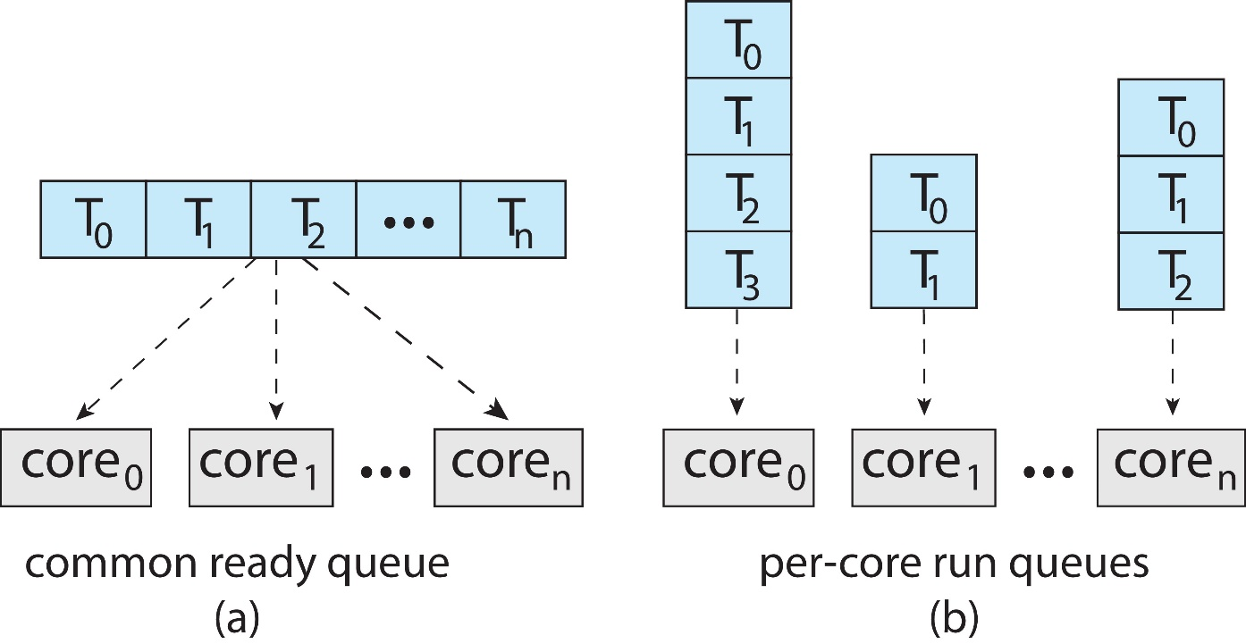
Multiple-Processor Scheduling
Symmetric multiprocessing (SMP) is where each processor is self scheduling
All threads may be in a common ready queue (a)
Each processor may have its own private queue of threads (b)

Slide 45
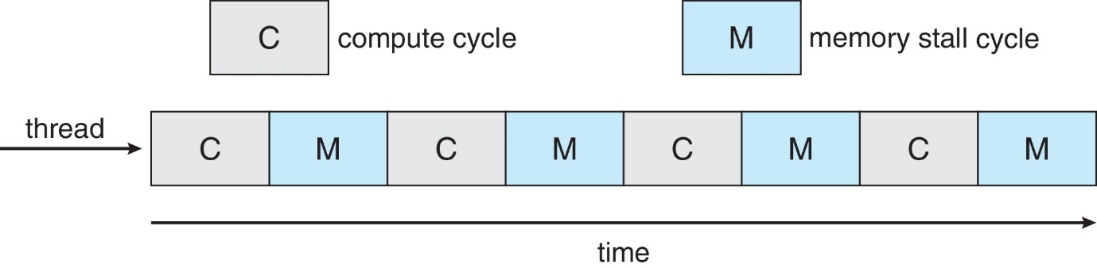
Multicore Processors
Recent trend to place multiple processor cores on same physical chip
Faster and consumes less power
Multiple threads per core also growing
Takes advantage of memory stall to make progress on another thread while memory retrieve happens

Slide 46
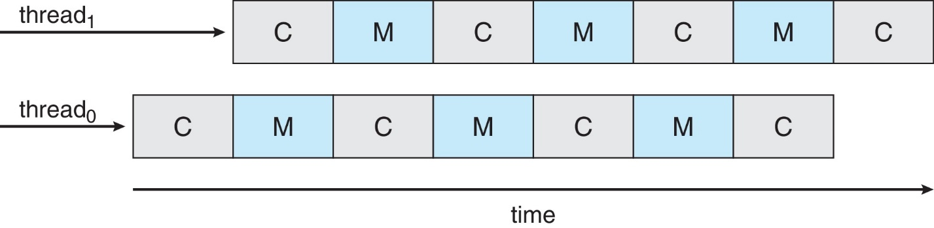
Multithreaded Multicore System
Each core has > 1 hardware threads
If one thread has a memory stall, switch to another thread

Slide 47
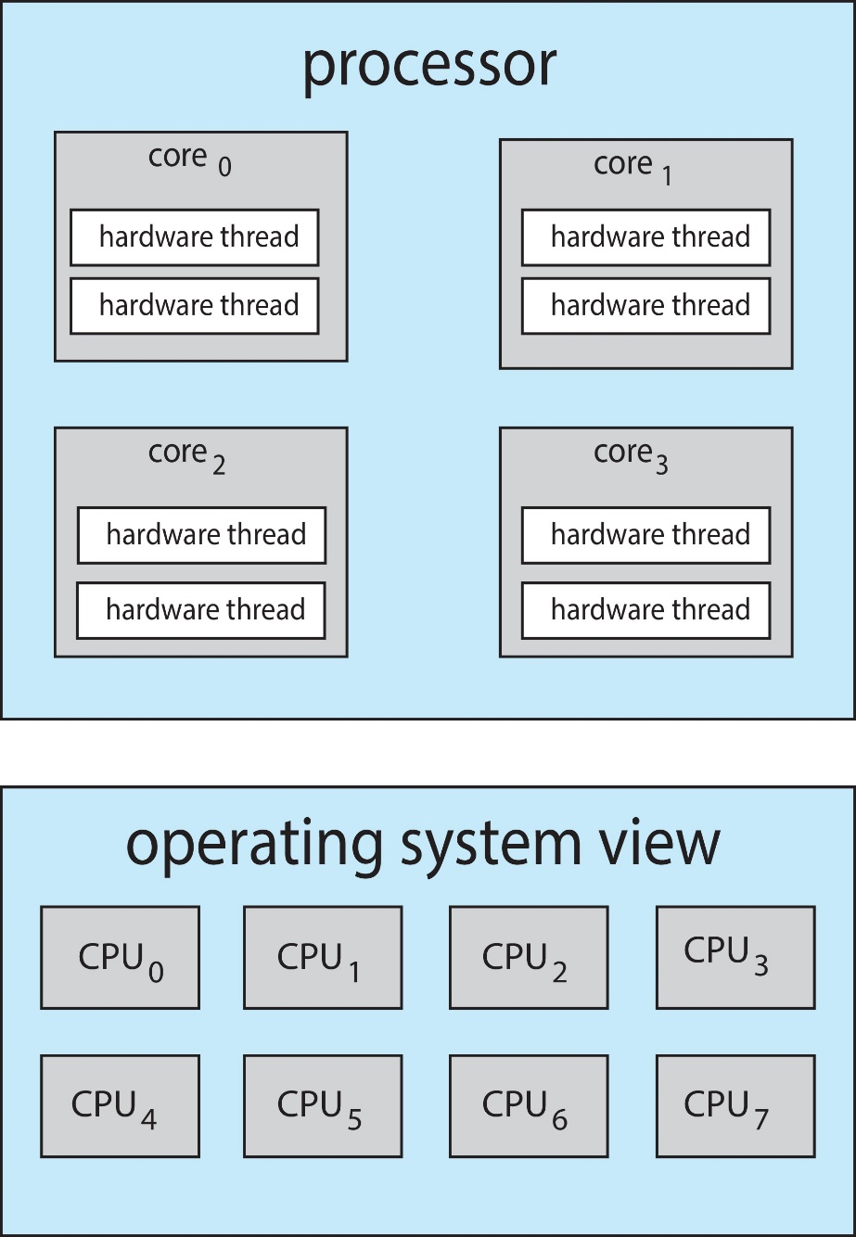
Multithreaded Multicore System
Chip-multithreading (CMT) assigns each core multiple hardware threads
Intel refers to this as hyperthreading
On a quad-core system with 2 hardware threads per core, the operating system sees 8 logical processors

Slide 48
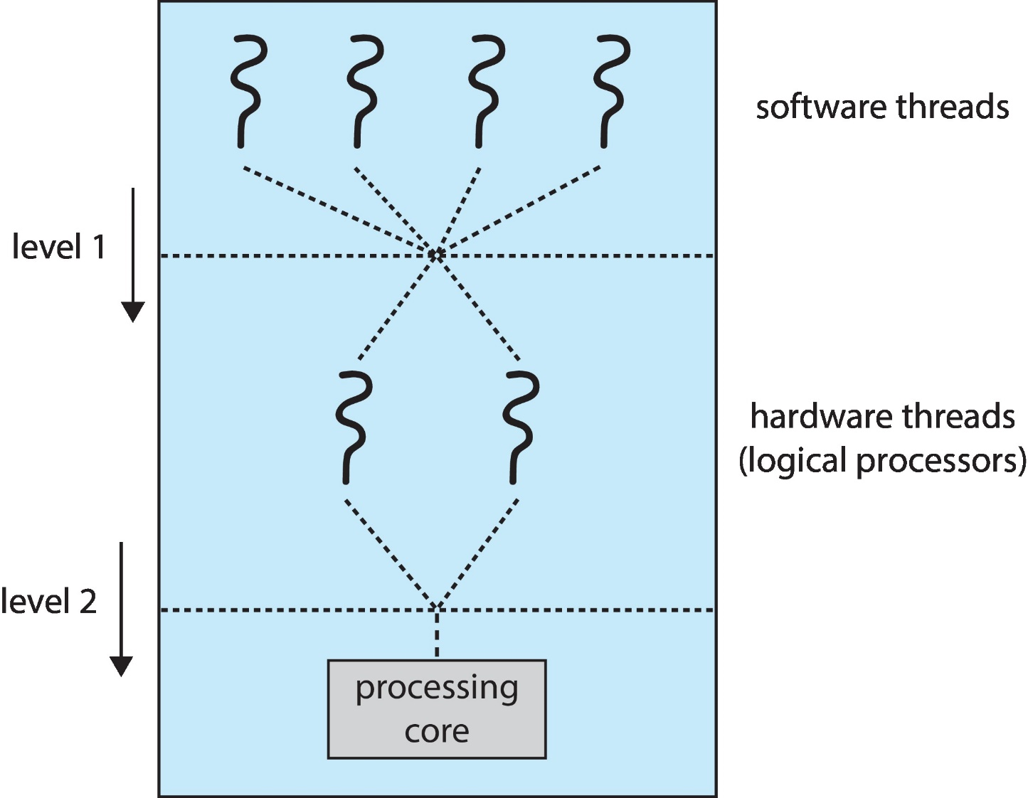
Multithreaded Multicore System
Two levels of scheduling:
The operating system deciding which software thread to run on a logical CPU
How each core decides which hardware thread to run on the physical core

Slide 49
Multiple-Processor Scheduling – Load Balancing
If SMP, need to keep all CPUs loaded for efficiency
Load balancing
attempts to keep workload evenly distributed
Push migration
periodic task checks load on each processor, and if found pushes task from overloaded CPU to other CPUs
Pull migration
idle processors pulls waiting task from busy processor

Slide 50
Multiple-Processor Scheduling – Processor Affinity
When a thread has been running on one processor, the cache contents of that processor stores the memory accesses by that thread
We refer to this as a thread having affinity for a processor (i.e., “processor affinity”)
Load balancing may affect processor affinity as a thread may be moved from one processor to another to balance loads, yet that thread loses the contents of what it had in the cache of the processor it was moved off of
Soft affinity
the operating system attempts to keep a thread running on the same processor, but no guarantees
Hard affinity
allows a process to specify a set of processors it may run on

Slide 51
NUMA and CPU Scheduling
If the operating system is NUMA-aware, it will assign memory closes to the CPU the thread is running on

Slide 52
Real-Time Process Scheduling

Slide 53
Real-Time CPU Scheduling
Can present obvious challenges
Soft real-time systems
Critical real-time tasks have the highest priority, but no guarantee as to when tasks will be scheduled
Hard real-time systems
task must be serviced by its deadline

Slide 54
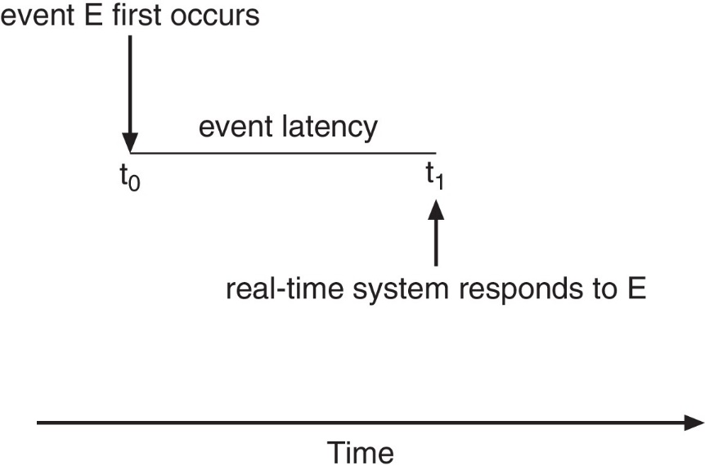
Real-Time CPU Scheduling
Event latency – the amount of time that elapses from when an event occurs to when it is serviced
Two types of latencies affect performance
Interrupt latency
time from arrival of interrupt to start of routine that services interrupt
Dispatch latency
time for schedule to take current process off CPU and switch to another

Slide 55
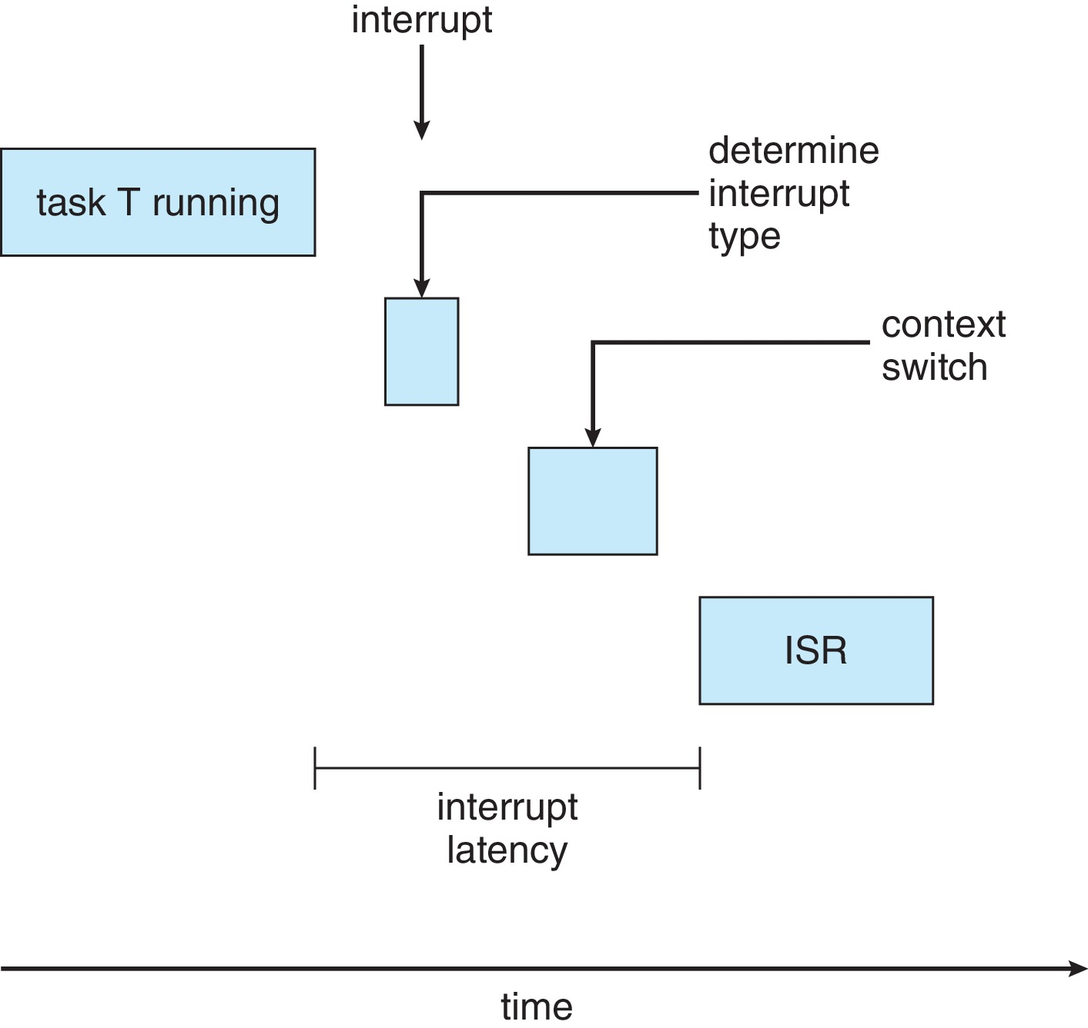
Interrupt Latency

Slide 56
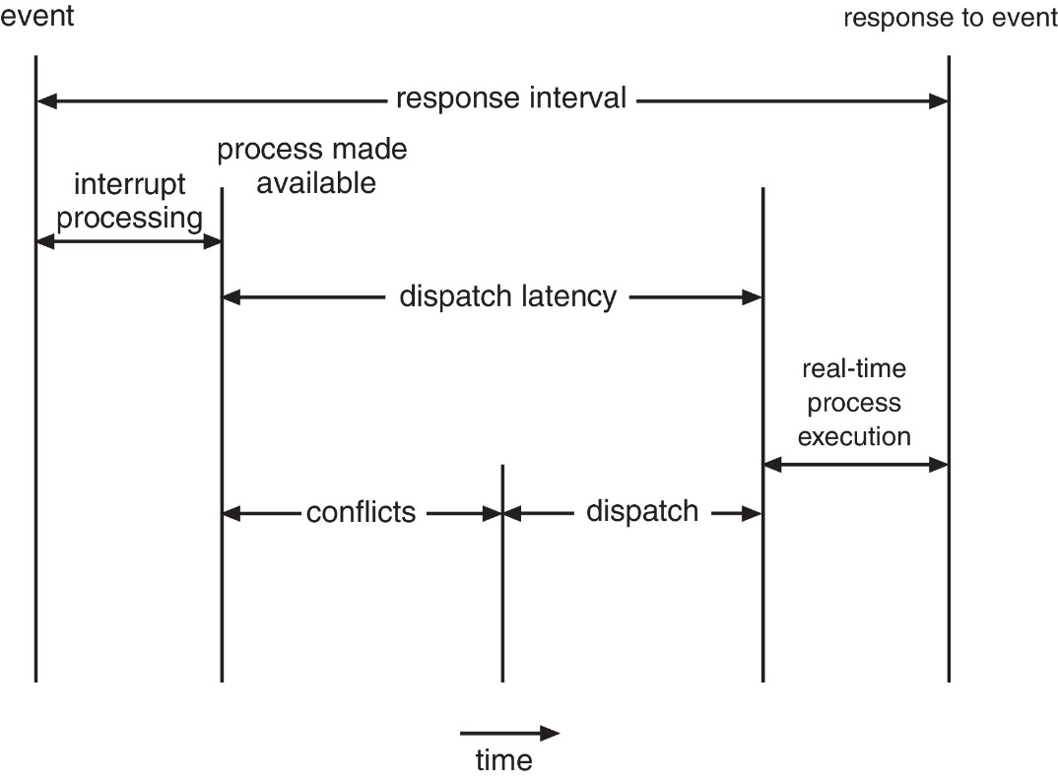
Dispatch Latency
Conflict phase of dispatch latency
Preemption of any process running in kernel mode
Release by low-priority process of resources needed by high-priority processes

Slide 57
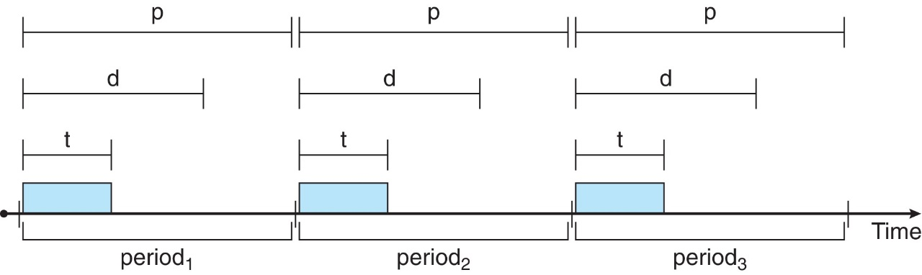
Priority-based Scheduling
For real-time scheduling, scheduler must support preemptive, priority-based scheduling
But only guarantees soft real-time
For hard real-time must also provide ability to meet deadlines
Processes have new characteristics: periodic ones require CPU at constant intervals
Has processing time t, deadline d, period p
0 ≤ t ≤ d ≤ p
Rate of periodic task is 1/p

Slide 58
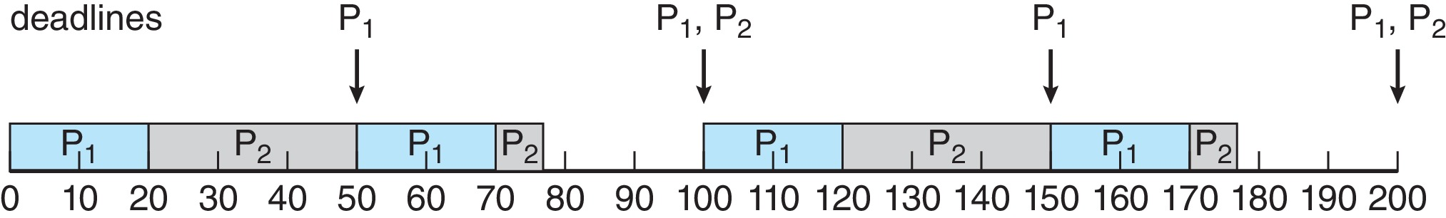
Rate Monotonic Scheduling
A priority is assigned based on the inverse of its period
Shorter periods → higher priority
Longer periods → lower priority
P1 is assigned a higher priority than P2

Slide 59
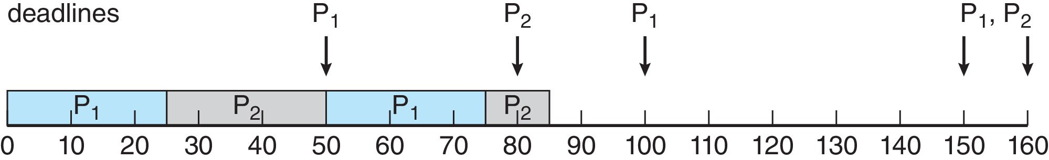
Missed Deadlines with Rate Monotonic Scheduling
Process P2 misses finishing its deadline at time 80

Slide 60
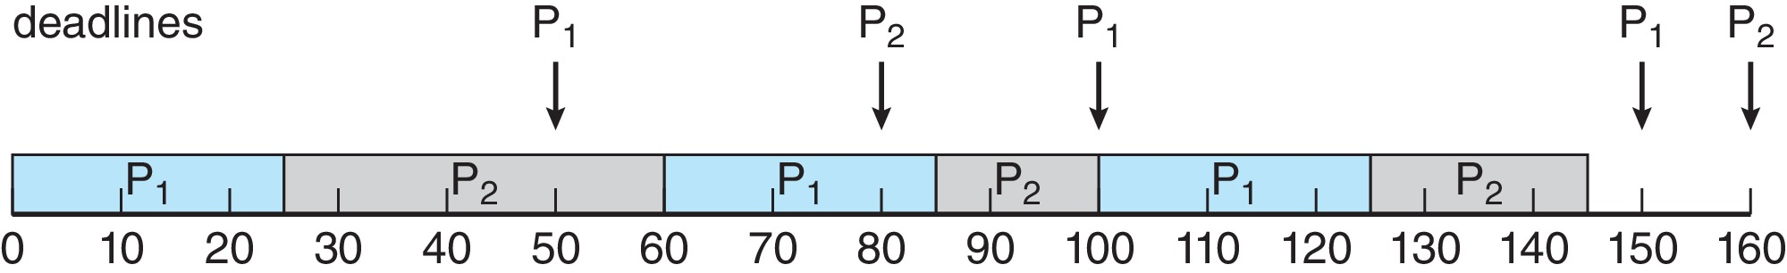
Earliest Deadline First Scheduling (EDF)
Priorities are assigned according to deadlines
The earlier the deadline, the higher the priority
The later the deadline, the lower the priority

Slide 61
Proportional Share Scheduling
T shares are allocated among all processes in the system
An application receives N shares where N < T
This ensures each application will receive N / T of the total processor time

Slide 62
POSIX Real-Time Scheduling
The POSIX.1b standard
API provides functions for managing real-time threads
Defines two scheduling classes for real-time threads
SCHED_FIFO - threads are scheduled using a FCFS strategy with a FIFO queue
There is no time-slicing for threads of equal priority
SCHED_RR - similar to SCHED_FIFO except time-slicing occurs for threads of equal priority
Defines two functions for getting and setting scheduling policy:
pthread_attr_getsched_policy(pthread_attr_t *attr, int *policy)
pthread_attr_setsched_policy(pthread_attr_t *attr, int policy)

Slide 63
POSIX Real-Time Scheduling API
#include <pthread.h>
#include <stdio.h>
#define NUM_THREADS 5
int main(int argc, char *argv[])
{
int i, policy; pthread_t_tid[NUM_THREADS];
pthread_attr_t attr;
/* get the default attributes */
pthread_attr_init(&attr);
/* get the current scheduling policy */ if (pthread_attr_getschedpolicy(&attr, &policy) != 0)
fprintf(stderr, "Unable to get policy.\n");
else {
if (policy == SCHED_OTHER) printf("SCHED_OTHER\n");
else if (policy == SCHED_RR) printf("SCHED_RR\n");
else if (policy == SCHED_FIFO) printf("SCHED_FIFO\n");
}

Slide 64
POSIX Real-Time Scheduling API
/* set the scheduling policy - FIFO, RR, or OTHER */ if (pthread_attr_setschedpolicy(&attr, SCHED_FIFO) != 0)
fprintf(stderr, "Unable to set policy.\n");
/* create the threads */ for (i = 0; i < NUM_THREADS; i++)
pthread_create(&tid[i],&attr,runner,NULL);
/* now join on each thread */ for (i = 0; i < NUM_THREADS; i++)
pthread_join(tid[i], NULL);
}
/* Each thread will begin control in this function */
void *runner(void *param) {
/* do some work ... */
pthread_exit(0);
}

Slide 65
Operating System Examples
Unix, Linux, Windows, and Solaris scheduling

Slide 66
Operating System Examples
Linux scheduling
Windows scheduling
Solaris scheduling

Slide 67
BSD Unix Scheduling
BSD Unix uses multilevel feed back queue approach, with 32 run queues
System processes use run queues 0 through 7
User processes use run queues 8 through 31
The dispatcher selects a process from higher priority queue
Within a queue RR scheduling is used
Time quantum vary among implementation, but all are less than 100ms
Each process has an external nice priority
The nice priority can vary between -20 and 20, -20 is the highest, 20 is the lowest user priority
Each process’s current priority id recalculated after each time quantum

Slide 68
Linux Scheduling Through Version 2.5
Prior to kernel version 2.5, ran variation of standard UNIX scheduling algorithm
Version 2.5 moved to constant order O(1) scheduling time
Preemptive, priority based
Two priority ranges: time-sharing and real-time
Real-time range from 0 to 99 and nice value from 100 to 140
Map into global priority with numerically lower values indicating higher priority
Higher priority gets larger q
Task run-able as long as time left in time slice (active)
If no time left (expired), not run-able until all other tasks use their slices
All run-able tasks tracked in per-CPU runqueue data structure
Two priority arrays (active, expired)
Tasks indexed by priority
When no more active, arrays are exchanged
Worked well, but poor response times for interactive processes

Slide 69
Linux Scheduling in Version 2.6.23 +
Completely Fair Scheduler (CFS)
Scheduling classes
Each has specific priority
Scheduler picks highest priority task in highest scheduling class
Rather than quantum based on fixed time allotments, based on proportion of CPU time
Two scheduling classes included, others can be added
default
real-time

Slide 70
Linux Scheduling in Version 2.6.23 +
Quantum calculated based on nice value from -20 to +19
Lower value is higher priority
Calculates target latency – interval of time during which task should run at least once
Target latency can increase if say number of active tasks increases
CFS scheduler maintains per task virtual run time in variable vruntime
Associated with decay factor based on priority of task – lower priority is higher decay rate
Normal default priority yields virtual run time = actual run time
To decide next task to run, scheduler picks task with lowest virtual run time

Slide 71
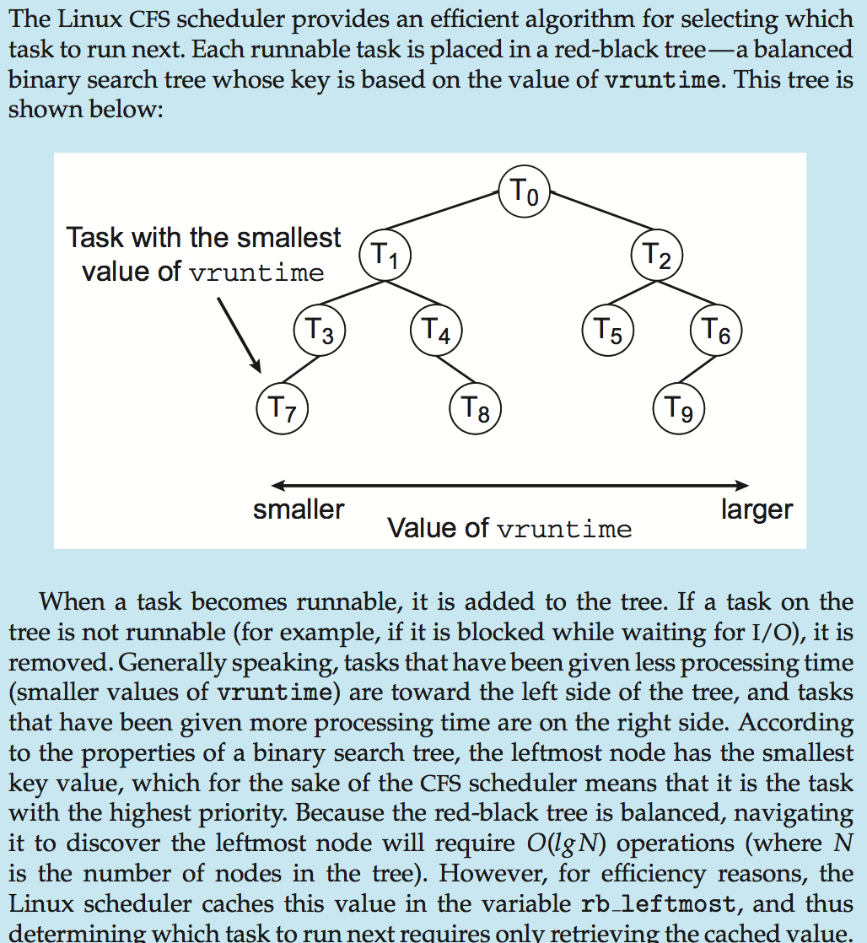
CFS Performance

Slide 72
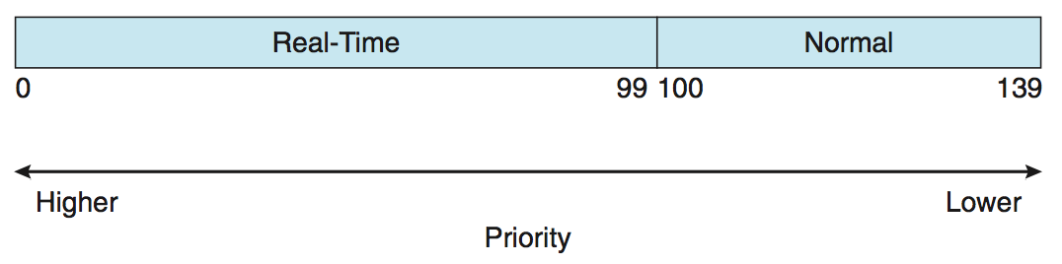
Linux Scheduling
Real-time scheduling according to POSIX.1b
Real-time tasks have static priorities
Real-time plus normal map into global priority scheme
Nice value of -20 maps to global priority 100
Nice value of +19 maps to priority 139

Slide 73
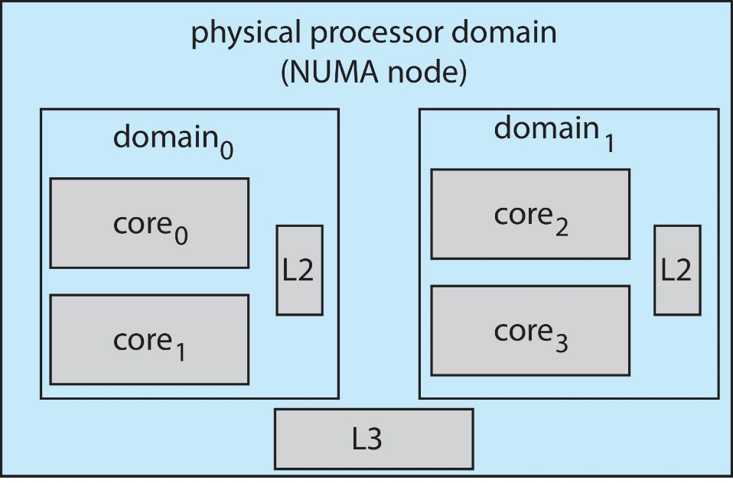
Linux Scheduling
Linux supports load balancing, but is also NUMA-aware
Scheduling domain is a set of CPU cores that can be balanced against one another.
Domains are organized by what they share (i.e., cache memory.) Goal is to keep threads from migrating between domains

Slide 74
Windows Scheduling
Windows use a priority based, preemptive scheduling algorithm
Windows scheduler ensures that highest priority thread will always run
Thread runs until
blocks
uses time slice
preempted by higher-priority thread
Windows dispatcher uses a 32-level priority scheme
Priorities are divided into two classes
Variable class (priorities from 0 to 15)
Real time class (priorities from 16 to 31)
Priority 0 is memory-management thread
Dispatcher uses a queue for each scheduling priority
If no run-able thread, runs idle thread

Slide 75
Windows Scheduling: Priority Classes
Win 32 API identifies several priority classes. These are;
REALTIME_PRIORITY_CLASS
HIGH_PRIORITY_CLASS
ABOVE_NORMAL_PRIORITY_CLASS
NORMAL_PRIORITY_CLASS
BELOW_NORMAL_PRIORITY_CLASS
IDLE_PRIORITY_CLASS
Within each of these priority there is a relative priority which are;
TIME_CRITICAL, HIGHEST, ABOVE_NORMAL, NORMAL, BELOW_NORMAL, LOWEST, IDLE
Priority class and relative priority combine to give numeric priority
Base priority is NORMAL within the class

Slide 76
Windows Scheduling: Priority Classes
If quantum expires, priority lowered, but never below base
If wait occurs, priority boosted depending on what was waited for
Foreground window given 3x priority boost
Windows 7 added user-mode scheduling (UMS)
Applications create and manage threads independent of kernel
For large number of threads, much more efficient
UMS schedulers come from programming language libraries like C++ Concurrent Runtime (ConcRT) framework

Slide 77
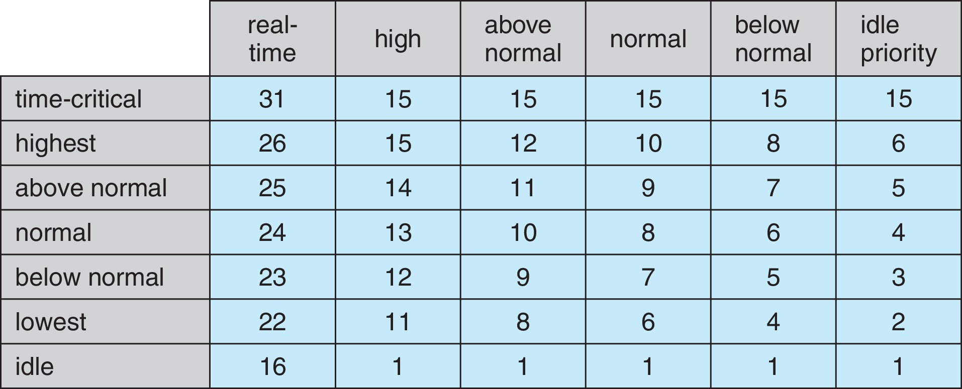
Windows Priorities

Slide 78
Solaris Scheduling
Solaris uses priority-based process scheduling
It has six classes of priority, which are;
Real time (RT)
System (SYS)
Fair Share (FSS)
Fixed priority (FP)
Time sharing (TS) (default)
Interactive (IA)
Given thread can be in one class at a time
Each class includes different set of priorities
Each class has its own scheduling algorithm
Real time processes has highest priority and interactive and time-sharing processes have least priorities
Solaris uses system class to run kernel processes, such as scheduler
System class is reserved for kernel processes

Slide 79
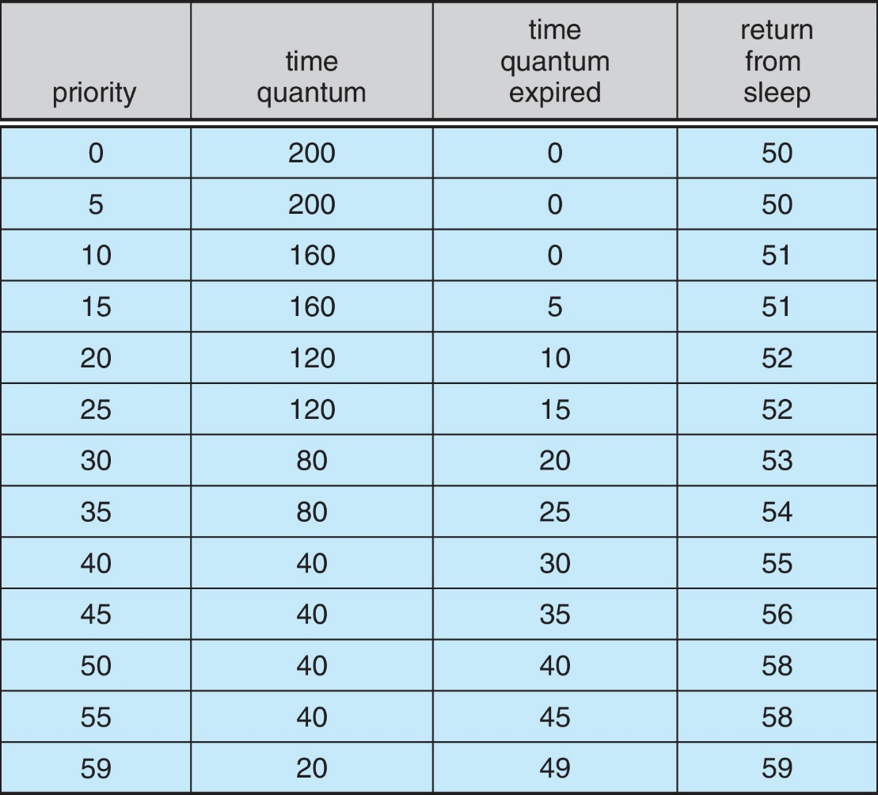
Solaris Dispatch Table

Slide 80
Solaris Scheduling

Slide 81
Solaris Scheduling
Scheduler converts class-specific priorities into a per-thread global priority
Thread with highest priority runs next
Runs until (1) blocks, (2) uses time slice, (3) preempted by higher-priority thread
Multiple threads at same priority selected via RR

Slide 82
Scheduling Algorithm’s Evaluation

Slide 83
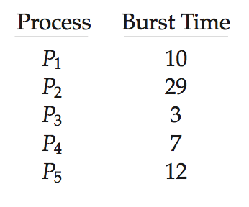
Algorithm Evaluation
How to select CPU-scheduling algorithm for an OS?
Determine criteria, then evaluate algorithms
Deterministic modeling
Type of analytic evaluation
Takes a particular predetermined workload and defines the performance of each algorithm for that workload
Consider 5 processes arriving at time 0:

Slide 84
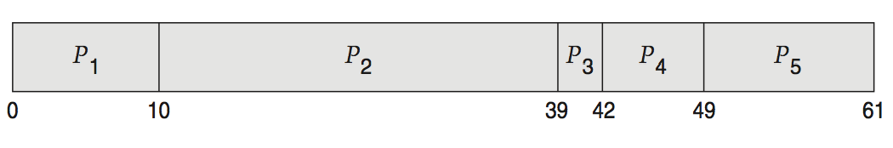
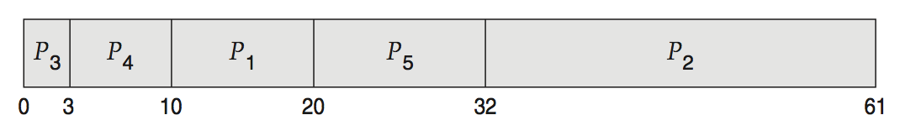
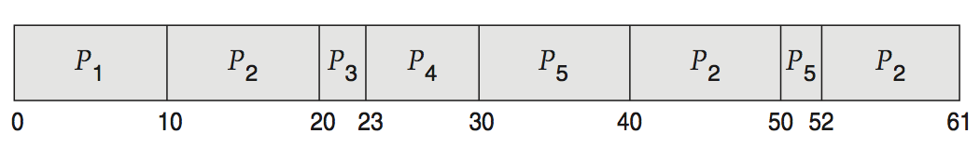
Deterministic Evaluation
For each algorithm, calculate minimum average waiting time
Simple and fast, but requires exact numbers for input, applies only to those inputs
FCS is 28ms:
Non-preemptive SFJ is 13ms:
RR is 23ms:

Slide 85
Queueing Models
Describes the arrival of processes, and CPU and I/O bursts probabilistically
Commonly exponential, and described by mean
Computes average throughput, utilization, waiting time, etc.
Computer system described as network of servers, each with queue of waiting processes
Knowing arrival rates and service rates
Computes utilization, average queue length, average wait time, etc.

Slide 86
Little’s Formula
n = average queue length
W = average waiting time in queue
λ = average arrival rate into queue
Little’s law – in steady state, processes leaving queue must equal processes arriving, thus: n = λ x W
Valid for any scheduling algorithm and arrival distribution
For example, if on average 7 processes arrive per second, and normally 14 processes in queue, then average wait time per process = 2 seconds

Slide 87
Simulations
Queueing models limited
Simulations more accurate
Programmed model of computer system
Clock is a variable
Gather statistics indicating algorithm performance
Data to drive simulation gathered via
Random number generator according to probabilities
Distributions defined mathematically or empirically
Trace tapes record sequences of real events in real systems

Slide 88
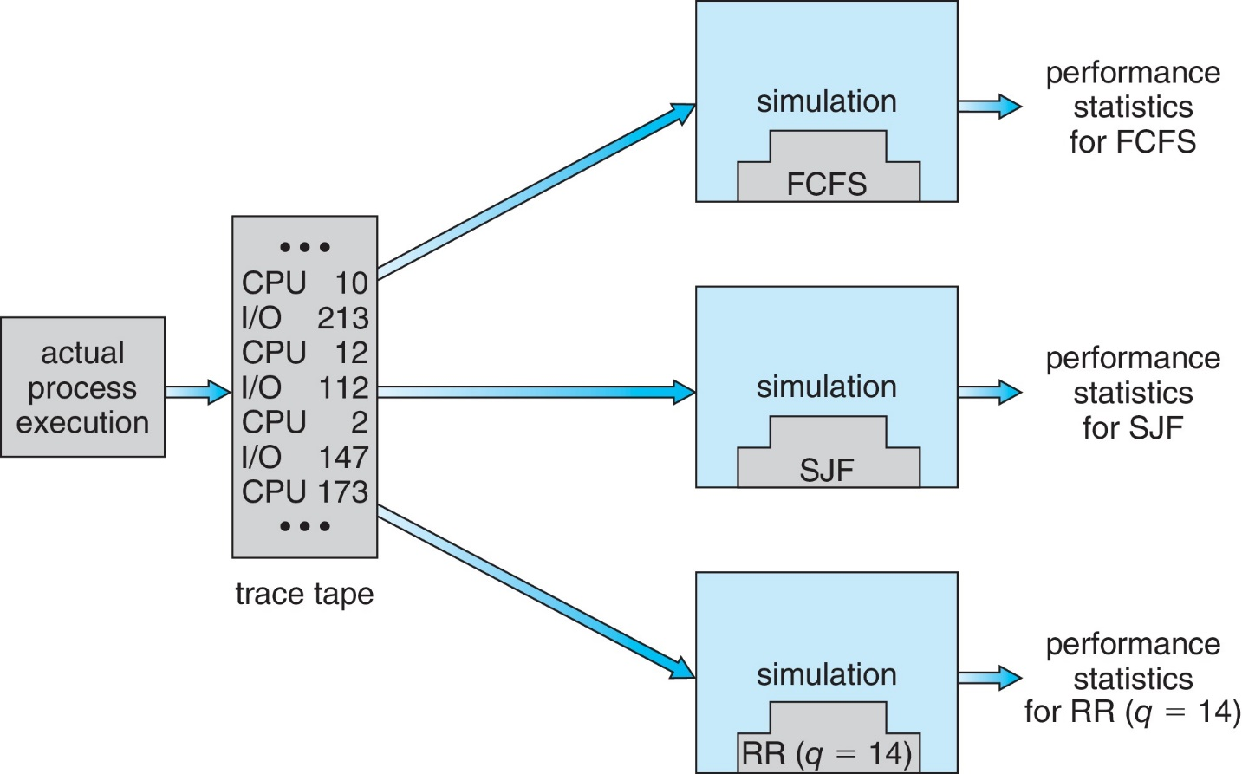
Evaluation of CPU Schedulers by Simulation

Slide 89
Implementation
Even simulations have limited accuracy
Just implement new scheduler and test in real systems
High cost, high risk
Environments vary
Most flexible schedulers can be modified per-site or per-system
Or APIs to modify priorities
But again environments vary

